Slide 1

Gita Autonomous College , BBSR
Presented By:
1. Ritwik Sonam
2. Satyabrata Nayak
3. Subhashree Raj
4. Priyanka Sutar
Under the Guidance of
Prof. (Dr.) Deepti Bala Mishra
HoD , MCA

Slide 2




Space Exploration And Documentation

Slide 3
Aim Of The Project
The website aims to provide information and resources on various aspects of space exploration, such as history, technology, missions, discoveries, and challenges. The website also intends to inspire and educate the public about the benefits and opportunities of space exploration, as well as the risks and ethical issues involved.”

Slide 4
Table of contents
03
01
02
04
05
06
Introduction
Literature Survey
History of Space Exploration
Android Application
Conclusion
User Authentication

Slide 5
Let’s go
Welcome Into Our Project

Slide 6

01
Introduction

Slide 7
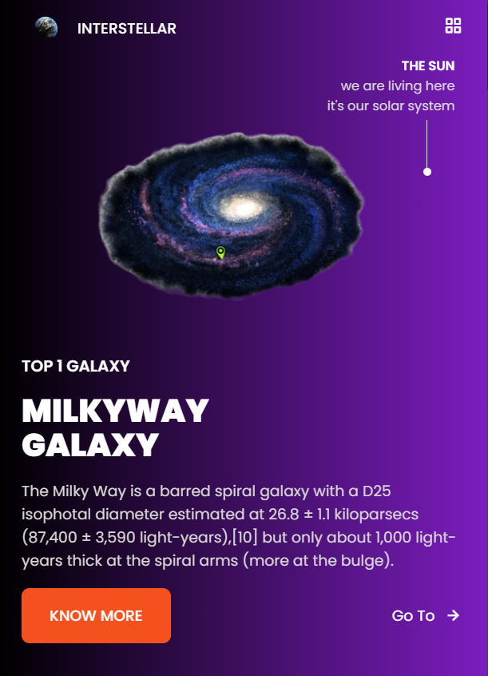
Explore the cosmos with our project, "Space Exploration and Documentation." Journey beyond Earth as we uncover the secrets of distant galaxies and celestial wonders. This website is your portal to a captivating exploration of the universe. Join us in this cosmic odyssey, where curiosity meets discovery.
Space is an almost perfect vacuum, nearly void of matter and with extremely low pressure. In space, sound doesn't carry because there aren't molecules close enough together to transmit sound between them. Not quite empty, bits of gas, dust and other matter floats around "emptier" areas of the universe, while more crowded regions can host planets, stars and galaxies.

Slide 8
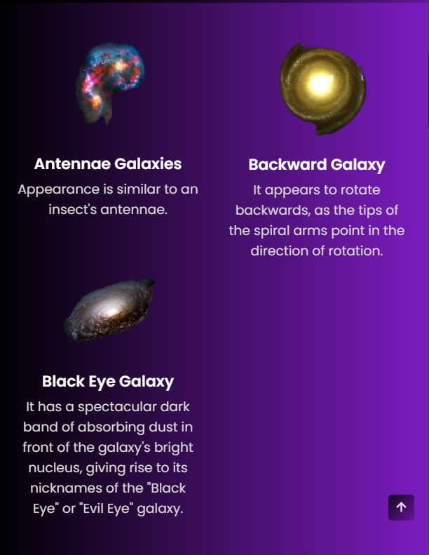

Some Galaxies

Slide 9
Space sciences
Solar System
Sun
Planets
Mars is actually a very cold place
Venus has extremely high temperatures
Neptune is the farthest planet from the Sun
Moons
Stars
Galaxies
Mercury is the closest planet to the Sun
Saturn is a gas giant and has several rings
Jupiter is the biggest planet of them all

Slide 10

02
Literature Survey

Slide 11


Founded by:-Neil deGrasse Tyson
"Space exploration is a force of nature unto itself that no other force in society can rival."

Slide 12
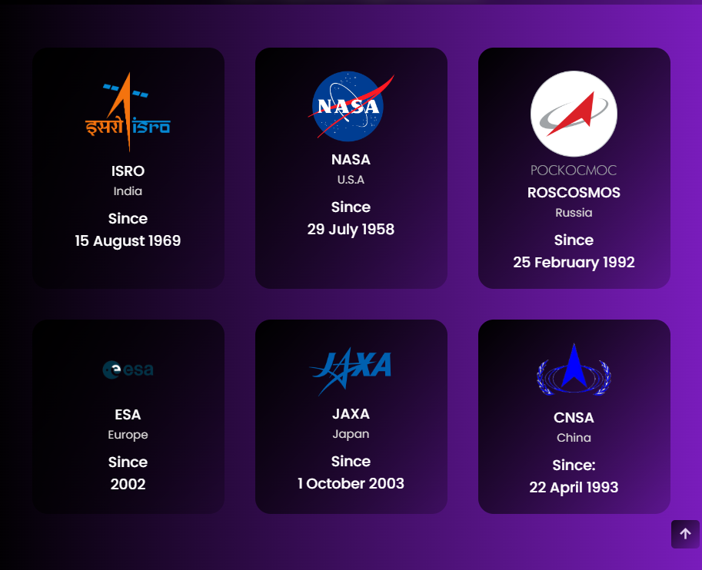
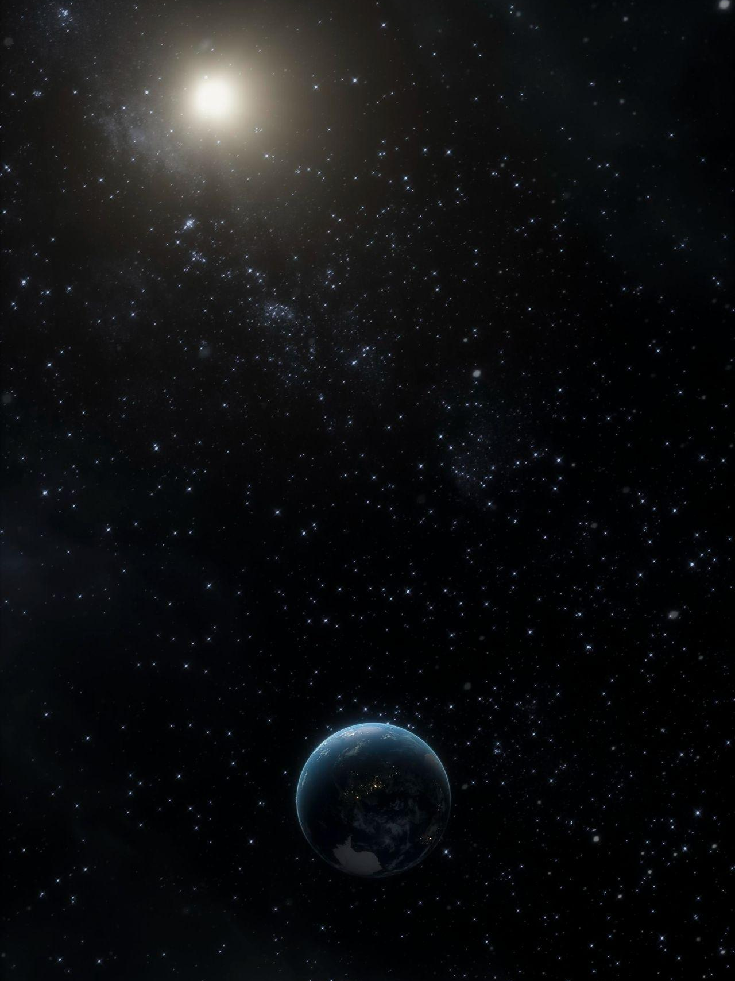
Review recent missions and projects in space exploration, such as NASA missions, ISRO , and JAXA research. Discuss advancements in technology, such as spacecraft design, propulsion systems, and instrumentation. Summarize the key scientific discoveries made through space exploration, such as the discovery of exoplanets, insights into the origins of the universe, and the search for life beyond Earth.

Slide 13
03
History of Space Exploration

Slide 14
The Copernican Revolution (16th Century): Nicolaus Copernicus proposed a heliocentric model of the solar system, challenging the geocentric view that the Earth was the center of the universe. This laid the foundation for modern astronomy. The Scientific Revolution (17th Century): Scientists like Johannes Kepler and Galileo Galilei made groundbreaking discoveries about the motion of planets and the nature of the universe, using telescopes to observe the night sky. The Space Age Begins (20th Century): 1957: The Soviet Union launched Sputnik 1, the first artificial satellite, marking the beginning of the space age. 1961: Yuri Gagarin became the first human to travel into space, orbiting the Earth aboard Vostok 1. 1969: NASA's Apollo 11 mission successfully landed astronauts Neil Armstrong and Buzz Aldrin on the moon, making Armstrong the first human to set foot on the lunar surface. Space Exploration Continues (Late 20th Century - Present): Space Probes: Numerous unmanned space probes have been sent to explore the planets, moons, and asteroids of our solar system, providing valuable data and images. Space Stations: The International Space Station (ISS), launched in 1998, serves as a research laboratory where astronauts conduct experiments in microgravity. Mars Exploration: Several missions have been sent to Mars to study its surface and search for signs of past life, with the ultimate goal of sending humans to the red planet.

Slide 15
Top 3 space exploration centers
NASA (USA)
Mercury is the closest planet to the Sun and the smallest of them all
Roscosmos (Russia)
Venus has a beautiful name and is the second planet from the Sun
ESA (Europe)
Despite being red, Mars is actually a cold place. It’s full of iron oxide dust

Slide 16
04
User Authentication

Slide 17

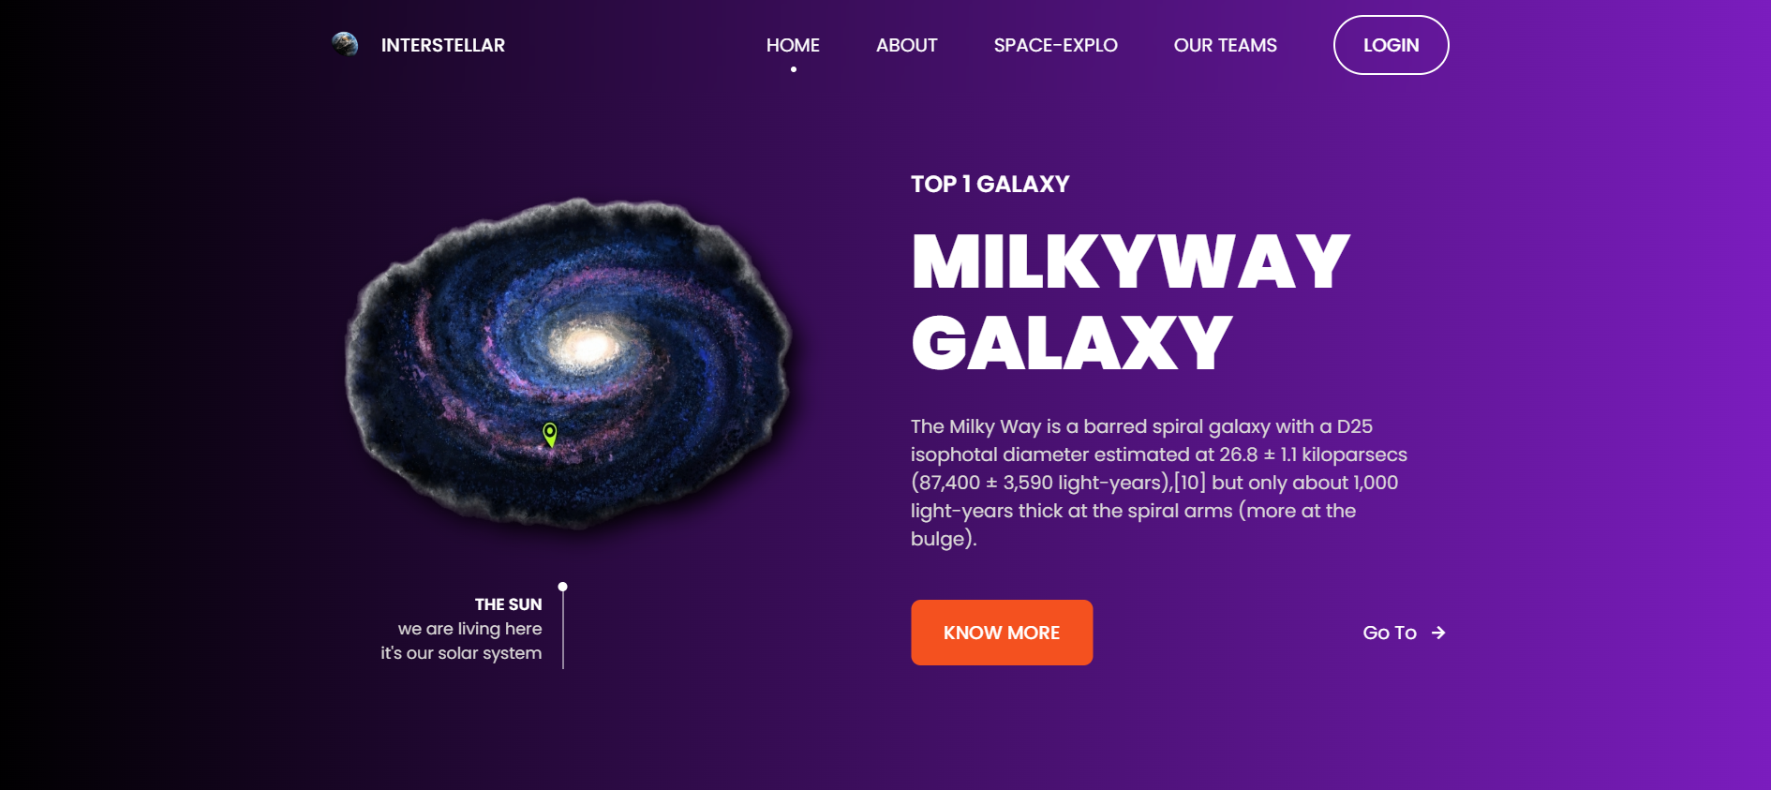
A login tab typically refers to a user interface element on a website or application that allows users to sign in to their accounts. The login tab is often located prominently on the homepage or at the top of the screen and usually consists of a text field for entering a username or email address and a password field for entering a password.

Slide 18
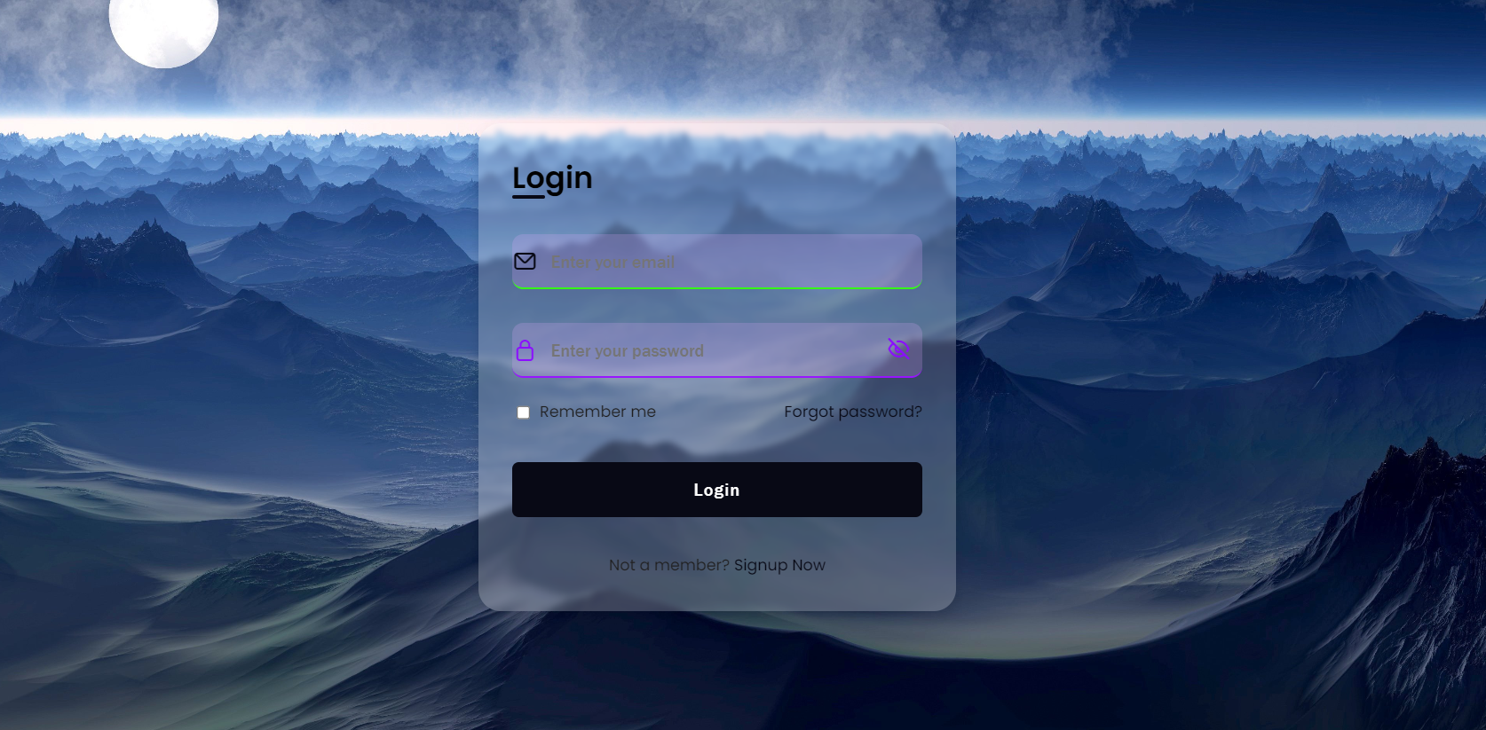
Once users enter their credentials and click the "Login" button, the system verifies their information and, if correct, grants them access to their account. If the credentials are incorrect, an error message is usually displayed, prompting users to try again.

Slide 19
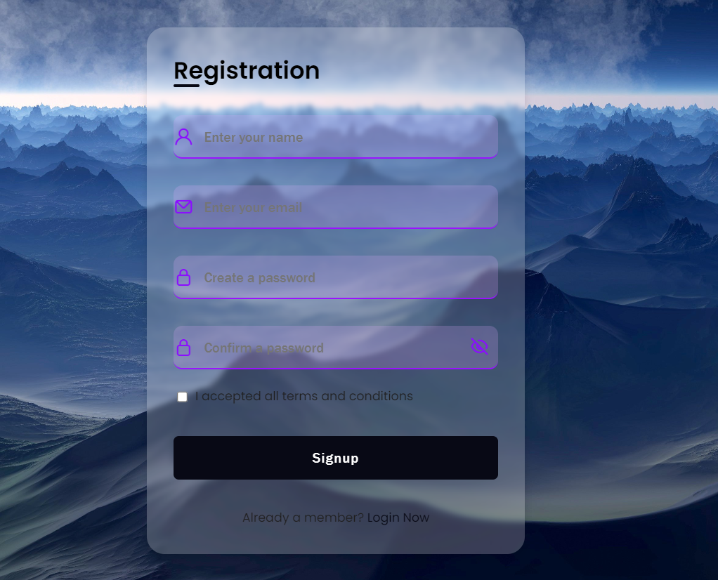
If u Want to create a Account , then click on Sign up button which is given below the login Button

Slide 20
05
Mobile Application Development

Slide 21
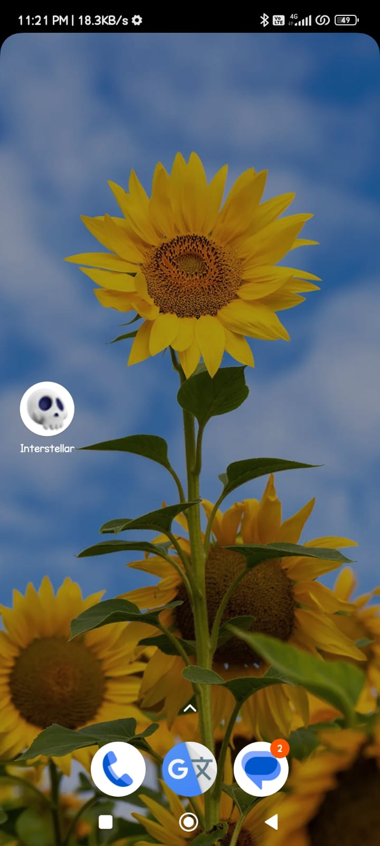
For mobile app development, you'll need to choose a platform (iOS, Android, or both) and a development approach (native, hybrid, or cross-platform). Here's a general overview: Platform: Decide whether you want to develop for iOS, Android, or both. Each platform has its own programming languages (Swift or Objective-C for iOS, Java or Kotlin for Android) and development environments (Xcode for iOS, Android Studio for Android). Development Approach: Native: Develop separate apps for each platform using their native languages and APIs. Provides the best performance and access to all platform features but requires more resources. Hybrid: Use web technologies (HTML, CSS, JavaScript) wrapped in a native container. Allows for faster development and code reuse but may have performance limitations.

Slide 22
06
Conclusion

Slide 23
In conclusion, our "Space Exploration and Documentation" project has ventured into the cosmic realms, unraveling the mysteries of the universe. Through meticulous experimentation and analysis, we've curated a platform that invites users to explore celestial wonders and delve into the vastness of space. The project's success lies in its ability to present captivating information, fostering curiosity and understanding about the cosmos

Slide 24


Our team
Ritwik Sonam
Satyabrata Nayak

Slide 25
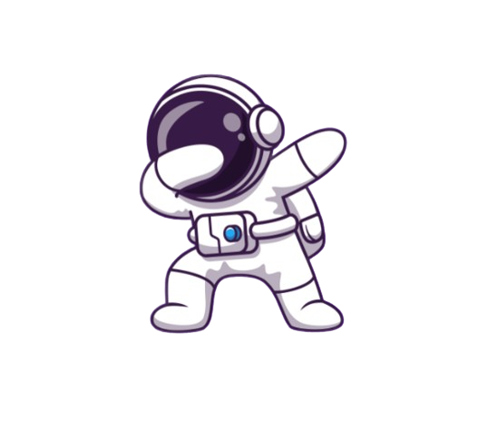
Thanks!
OUR WEBSITES:
https://ritwiksonam.github.io/SpaceResearch/

